Slide 1


Slide 2
Objectives:
To discuss the delivery of packets in the network layer and distinguish between direct and indirect delivery.
To discuss the forwarding of packets in the network layer and distinguish between destination-address–based forwarding and label-based forwarding.
To discuss different forwarding techniques, including next-hop, network-specific, host-specific, and default.
To discuss the contents of routing tables in classful and classless addressing and some algorithms used to search the tables.
To introduce MPLS technology and show how it can achieve label based forwarding.
To list the components of a router and explain the purpose of each component and their relations to other components.

Slide 3
6-1 DELIVERY
The network layer supervises the handling of the packets by the underlying physical networks.
We define this handling as the delivery of a packet.
Delivery of a packet to its final destination is accomplished using two different methods of delivery:
  Direct
  Indirect.

Slide 4
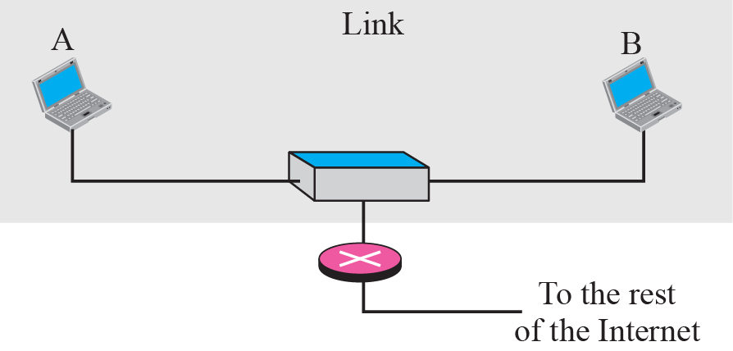
Direct delivery
In a direct delivery, the final destination of the packet is a host connected to the same physical network as the deliverer.
Direct delivery occurs when the source and destination of the packet are located on the same physical network or if the delivery is between the last router and the destination host

Slide 5
Contd..
The sender can easily determine if the delivery is direct.
It can extract the network address of the destination (using the mask) and compare this address with the addresses of the networks to which it is connected.
If a match is found, the delivery is direct.
In direct delivery, the sender uses the destination IP address to find the destination physical address.
The IP software then gives the destination IP address with the destination physical address to the data link layer for actual delivery.

Slide 6
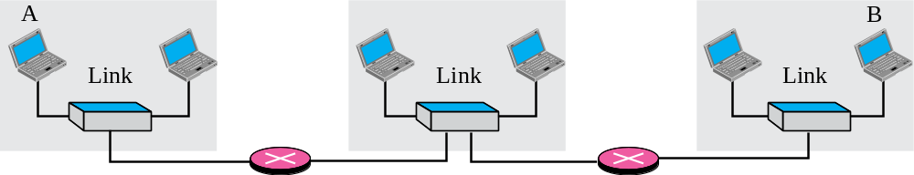
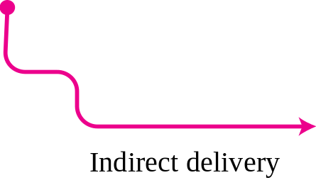
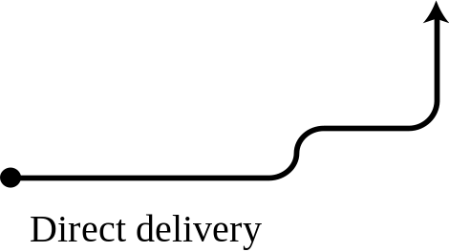

Indirect delivery
If the destination host is not on the same network as the deliverer, the packet is delivered indirectly.
In an indirect delivery, the packet goes from router to route reaches the one connected to the same physical network as its final destination.

Slide 7
Contd..
In an indirect delivery, the sender uses the destination IP address and a routing table to find the IP address of the next router to which the packet should be delivered.
The sender then uses ARP to find the physical address of the next router.
In direct delivery, the address mapping is between the IP address of the final destination and the physical address of the final destination.
In an indirect delivery, the address mapping is between the IP address of the next router and the physical address of the next router.
Delivery always involves one direct delivery but zero or more indirect deliveries.

Slide 8
6-2 FORWARDING
Forwarding means to place the packet in its route to its destination.
Internet today is made of a combination of links (networks), forwarding means to deliver the packet to the next hop (which can be the final destination or the intermediate connecting device).
IP protocol was originally designed as a connectionless protocol, today the tendency is to use IP as a connection-oriented protocol.
When IP is used as a connectionless protocol, forwarding is based on the destination address of the IP datagram;
When the IP is used as a connection-oriented protocol, forwarding is based on the label attached to an IP datagram

Slide 9
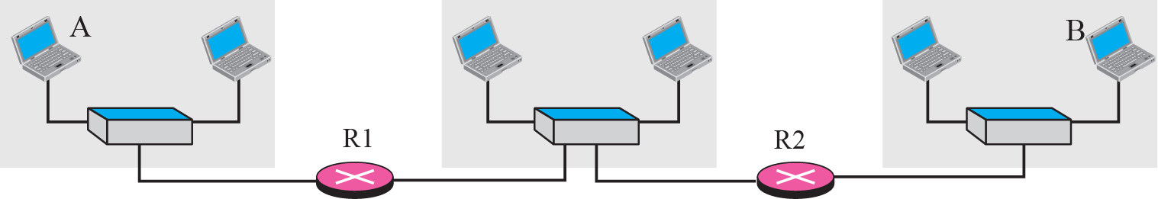
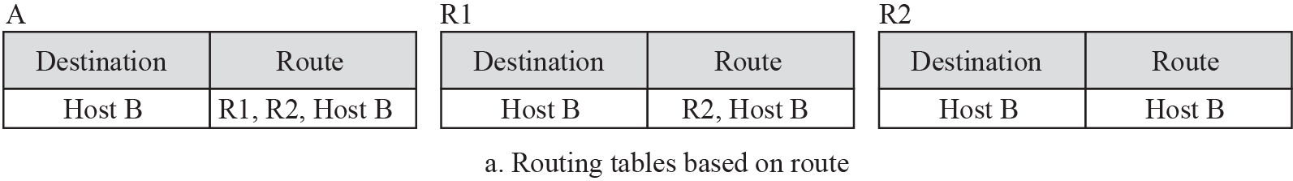
Contd..
In this case, forwarding requires a host or a router to have a routing table.
When a host has a packet to send or when a router has received a packet to be forwarded, it looks at this table to find the route to the final destination.
This simple solution is inefficient today in an internetwork such as the Internet because the number of entries needed in the routing table would make table lookups inefficient.

Slide 10
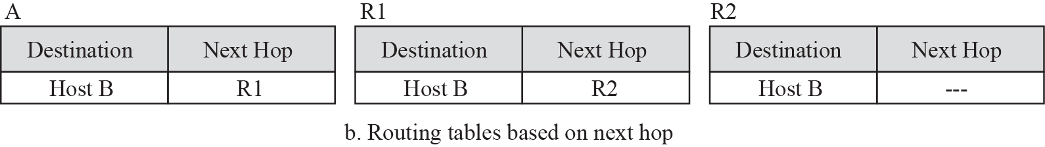
Contd..
Forwarding Techniques: Several techniques can make the size of the routing table manageable and also handle issues such as security.
Next-Hop Method: One technique to reduce the contents of a routing table. Here, the routing table holds only the address of the next hop instead of information about the complete route.

Slide 11
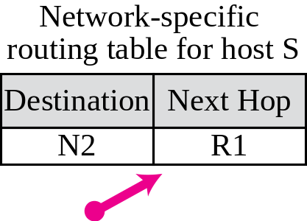
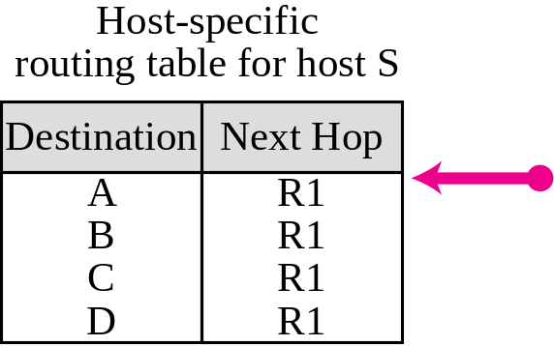
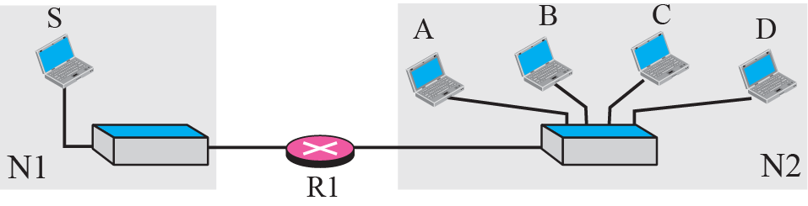
Contd..
Network-specific method
Another techniques to reduce the routing table and simplilify the searching process.
Here, instead of having an entry for every destination host connected to the same physical network, we have only one entry that defines the address of the destination network itself.
Treat all hosts connected to the same network as one single entity.

Slide 12
Contd..
Host-specific Method
In the host-specific method, the destination host address is given in the routing table.
Here efficiency is sacrificed for other advantages: There are occasions in which the administrator wants to have more control over routing.
For example, if the administrator wants all packets arriving for host B delivered to router R3 instead of R1, one single entry in the routing table of host A can explicitly define the route.
Host-specific routing is used for purposes such as checking the route or providing security measures.

Slide 13
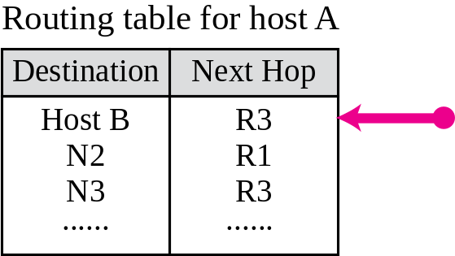
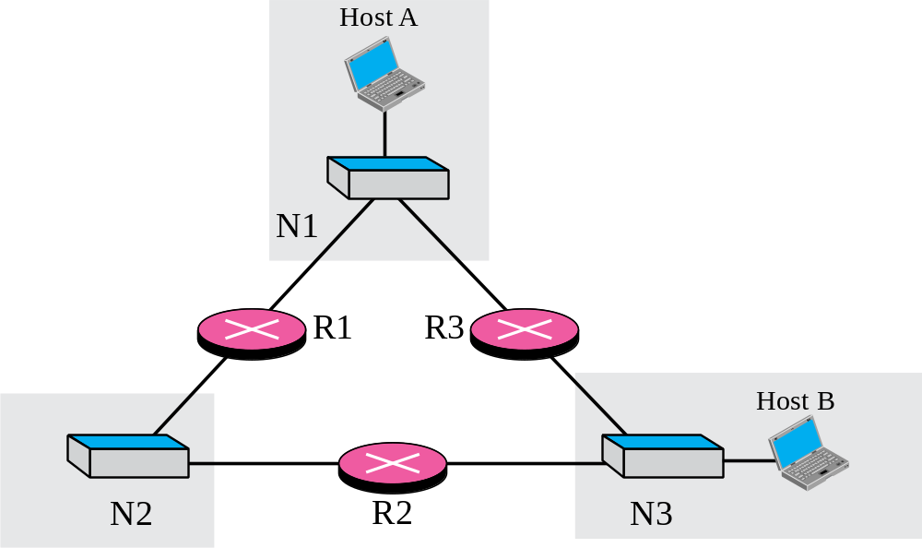
Contd..

Slide 14
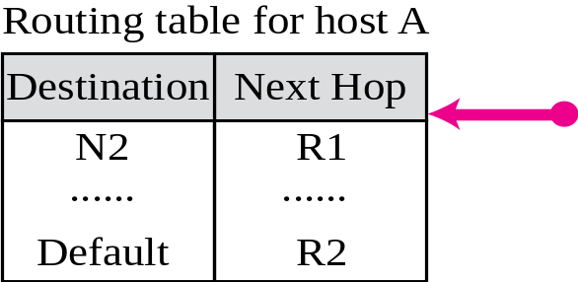
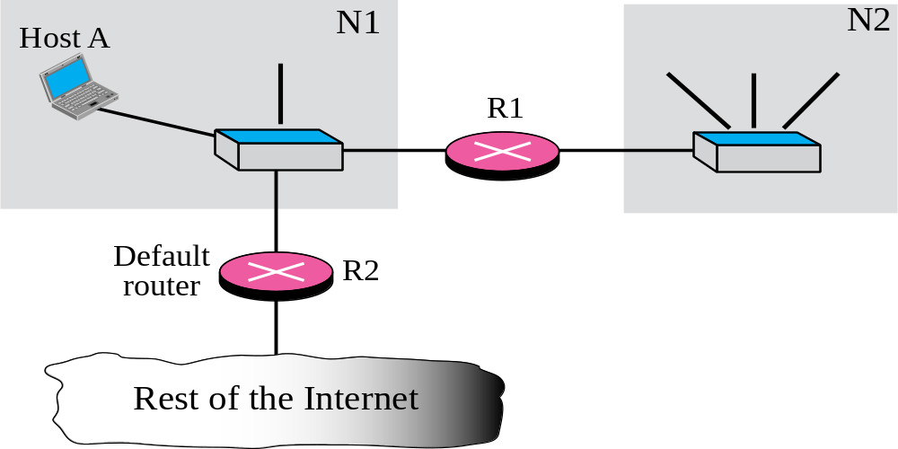
Contd..
Default Method
Another technique to simplify routing is called the default method.
In Figure 6.6 host A is connected to a network with two routers. Router R1 routes the packets to hosts connected to network N2. However, for the rest of the Internet, router R2 is used.
So instead of listing all networks in the entire Internet, host A can just have one entry called the default (normally defined as network address 0.0.0.0).

Slide 15
Contd..
Forwarding with classful addressing
Classful addressing has several disadvantages.
However, the existence of a default mask in a classful address makes the forwarding process simple.
Discuss
Forwarding without subnetting : contents of a routing table and forwarding module for the situation in which there is no subnetting.
Forwarding with subnetting

Slide 16
Contd..
Forwarding without Subnetting
In classful addressing, most of the routers in the global Internet are not involved in subnetting.
Subnetting happens inside the organization.
A typical forwarding module in this case can be designed using three tables, one for each unicast class (A, B, C).
If the router supports multicasting, another table can be added to handle class D addresses.
Having three different tables makes searching more efficient

Slide 17
Contd..
Forwarding without Subnetting
Each routing table has a minimum of three columns:
  The network address of the destination network.
  The next-hop address tells us to which router the packet must be delivered for an indirect delivery. This column is empty for a direct delivery.
  The interface number defines the outgoing port from which the packet is sent out.

Slide 18
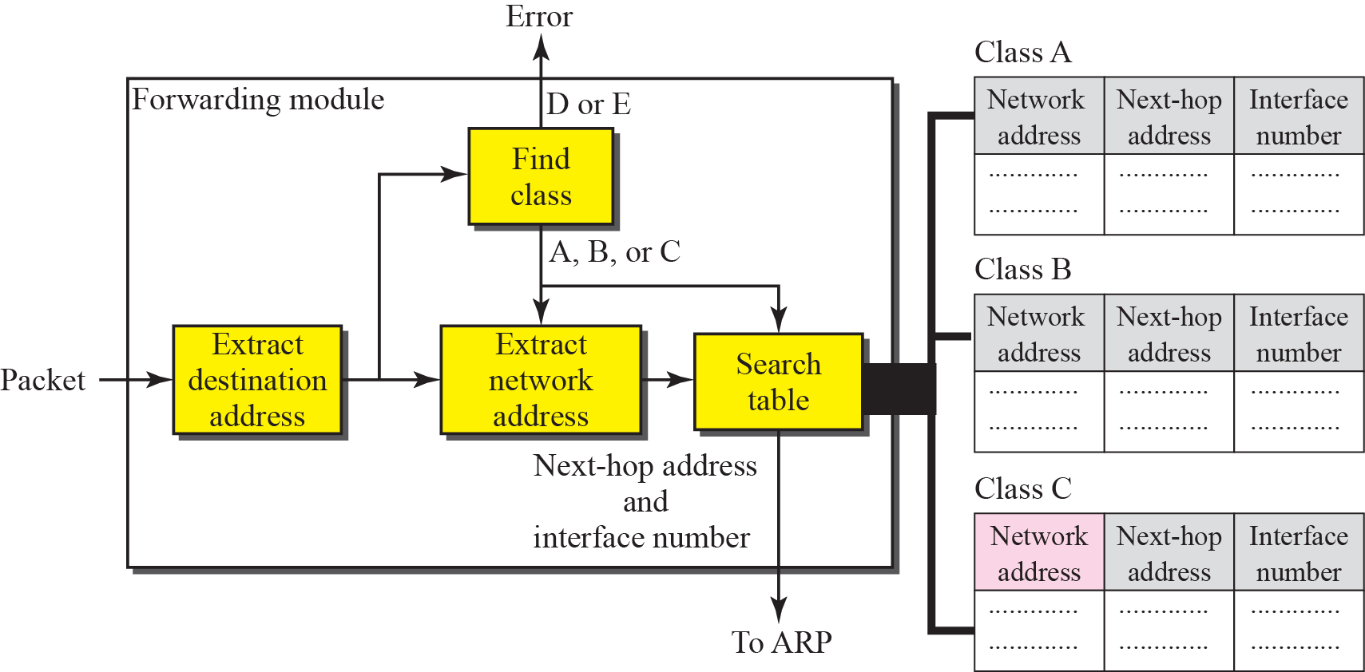
Simplified forwarding module in classful address without subnetting

Slide 19
Contd..
Forwarding without Subnetting
The forwarding module follows these steps:
The destination address of the packet is extracted.
A copy of the destination address is used to find the class of the address. This is done by shifting the copy of the address 28 bits to the right. The result is a 4-bit number between 0 and 15. If the result is
  0 to 7, the class is A.
  8 to 11, the class is B.
  12 or 13, the class is C .
  14, the class is D.
  15, the class is E.
3. The result of Step 2 for class A, B, or C and the destination address are used to extract the network address. This is done by masking off (changing to 0s) the rightmost 8, 16, or 24 bits based on the class

Slide 20
Contd..
The class of the address and the network address are used to find next-hop information. The class determines which table is to be searched. The module searches this table for the network address. If a match is found, the next-hop address and the interface number of the output port are extracted from the table. If no match is found, the default is used.
The ARP module uses the next-hop address and the interface number to find the physical address of the next router. It then asks the data link layer to deliver the packet to the next hop.

Slide 21
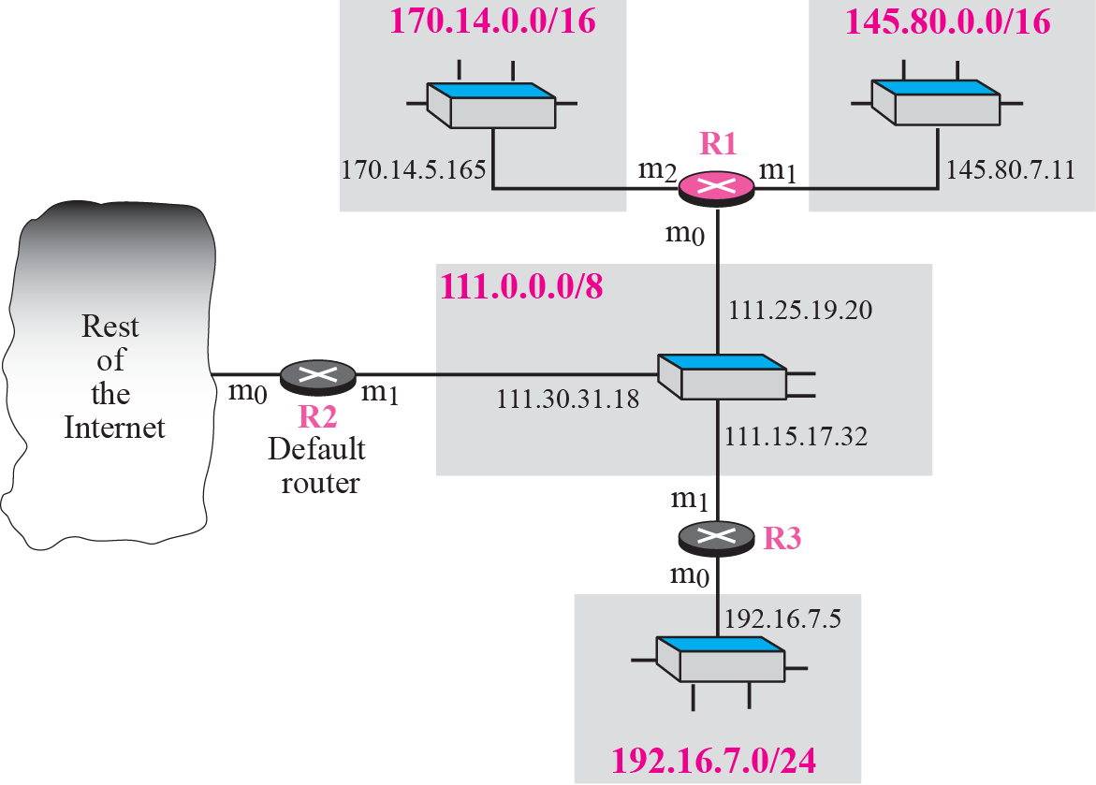
Example 1
Figure 6.8 shows an imaginary part of the Internet. Show the routing tables for router R1.

Slide 22
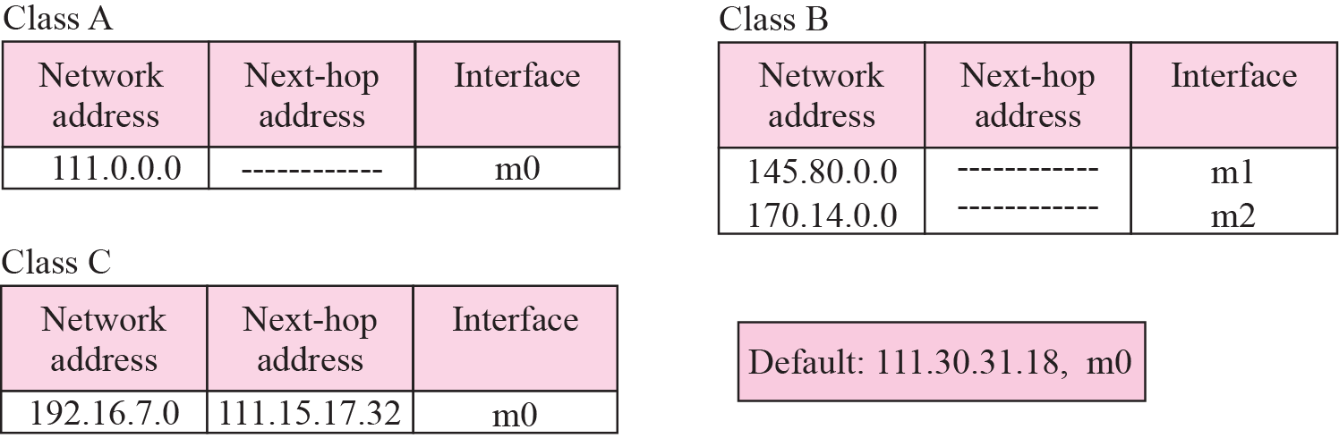
Contd..
Solution
The three tables used by router R1.
Some entries in the next-hop address column are empty because in these cases, the destination is in the same network to which the router is connected (direct delivery).

Slide 23
Example 2
Router R1 in Figure receives a packet with destination address 192.16.7.14. Show how the packet is forwarded.

Slide 24
Contd..
Solution
The destination address is 11000000 00010000 000001110 0001110.
A copy of the address is shifted 28 bits to the right. The result is 00000000 00000000 00000000 00001100 or 12.
The destination network is class C.
The network address is extracted by masking off the leftmost 24 bits of the destination address; the result is 192.16.7.0.
The table for Class C is searched.
The network address is found in the first row. The next-hop address 111.15.17.32. and the interface m0 are passed to ARP.

Slide 25
Example 3
Router R1 in Figure receives a packet with destination address 167.24.160.5. Show how the packet is forwarded.

Slide 26
Contd..
Solution
The destination address in binary is 10100111 00011000 10100000 00000101.
A copy of the address is shifted 28 bits to the right. The result is 00000000 00000000 00000000 00001010 or 10.
The class is B.
The network address can be found by masking off 16 bits of the destination address, the result is 167.24.0.0.
The table for Class B is searched. No matching network address is found.
The packet needs to be forwarded to the default router (the network is somewhere else in the Internet).
The next-hop address 111.30.31.18 and the interface number m0 are passed to ARP.

Slide 27
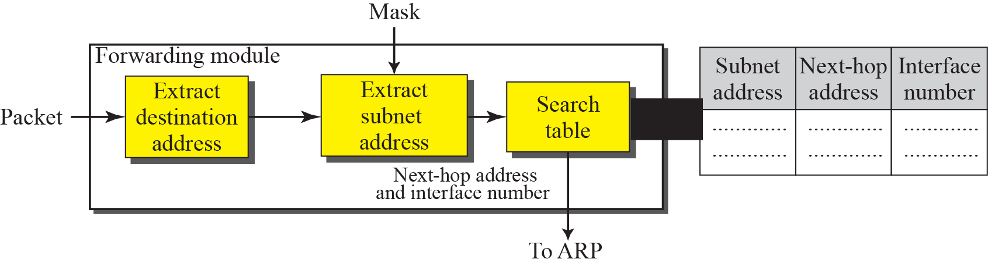
Contd..
Forwarding with Subnetting
In classful addressing, subnetting happens inside the organization.
The routers that handle subnetting are either at the border of the organization site or inside the site boundary.
If the organization is using variable-length subnetting, we need several tables; otherwise, we need only one table.
Figure 6.10 shows a simplified module for fixed-length subnetting

Slide 28
Contd..
Forwarding with Subnetting
The module extracts the destination address of the packet.
If the destination address matches any of the host-specific addresses in the table, the next-hop and the interface number is extracted from the table.
The destination address and the mask are used to extract the subnet address.
The table is searched using the subnet address to find the next-hop address and the interface number. If no match is found, the default is used.
The next-hop address and the interface number are given to ARP .

Slide 29
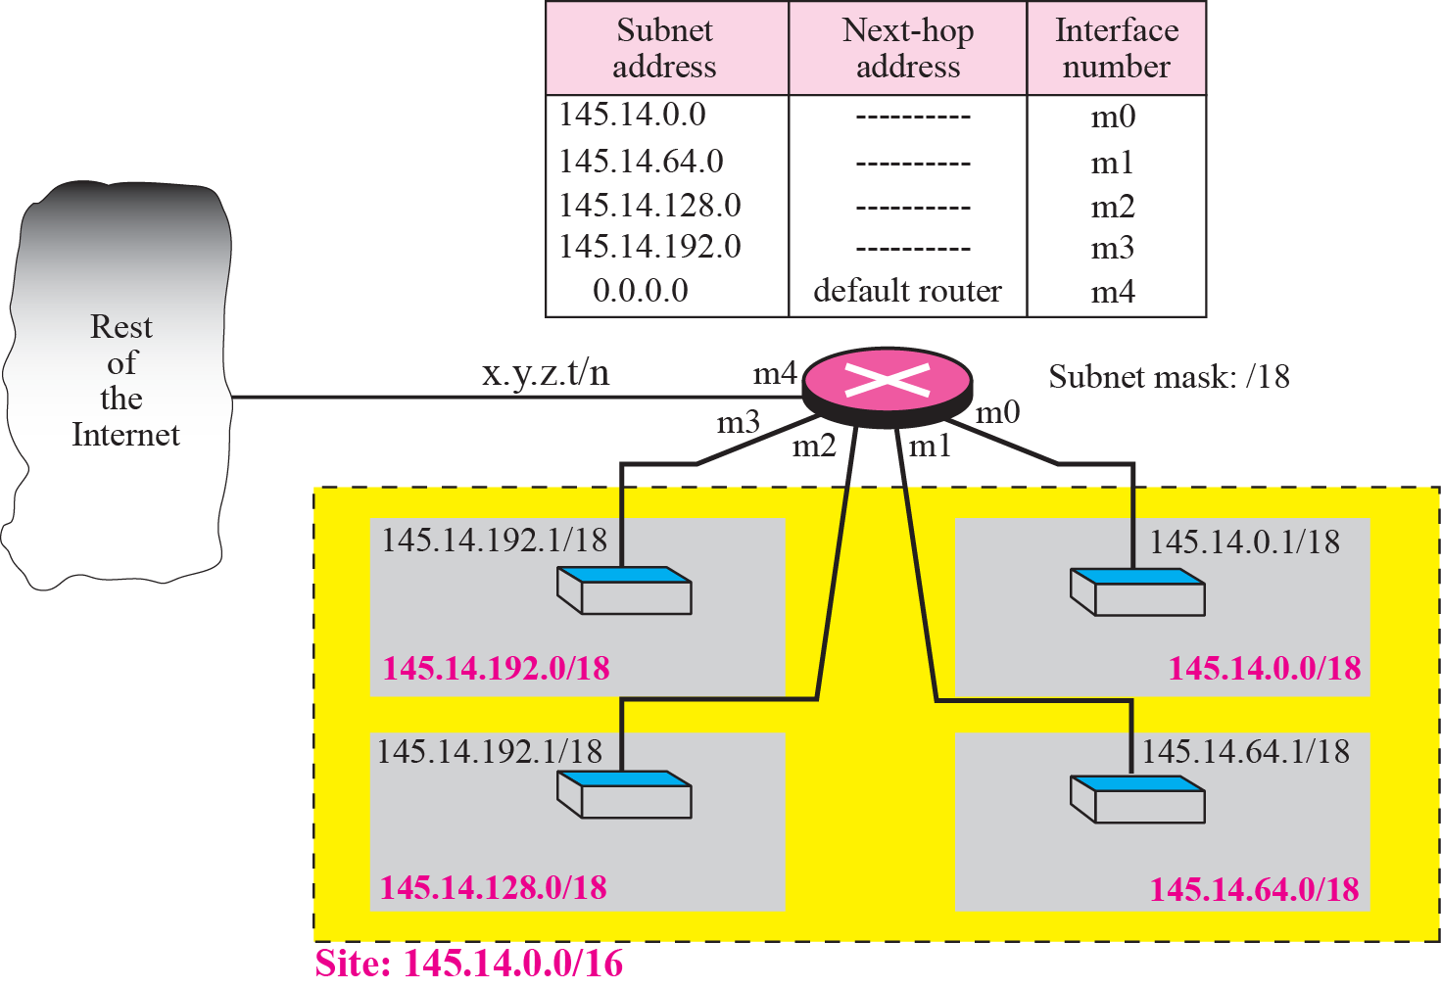
Example 4
Figure shows a router connected to four subnets.

Slide 30
Contd..
First, the site address is 145.14.0.0/16 (a class B address).
Every packet with destination address in the range 145.14.0.0 to 145.14.255.255 is delivered to the interface m4 and distributed to the final destination subnet by the router.
Second, the address x.y.z.t/n for the interface m4 because we do not know to which network this router is connected.
Third, the table has a default entry for packets that are to be sent out of the site. The router is configured to apply the subnet mask /18 to any destination address.

Slide 31
Example 5
The router in Figure receives a packet with destination address 145.14.32.78. Show how the packet is forwarded.

Slide 32
Contd..
Solution
The mask is /18. After applying the mask, the subnet address is 145.14.0.0.
The packet is delivered to ARP with the next-hop address 145.14.32.78 and the outgoing interface m0.

Slide 33
Example 6
A host in network 145.14.0.0 in Figure has a packet to send to the host with address 7.22.67.91. Show how the packet is routed.

Slide 34
Contd..
Solution
The router receives the packet and applies the mask (/18). The network address is 7.22.64.0.
The table is searched and the address is not found.
The router uses the address of the default router (not shown in figure) and sends the packet to that router.

Slide 35
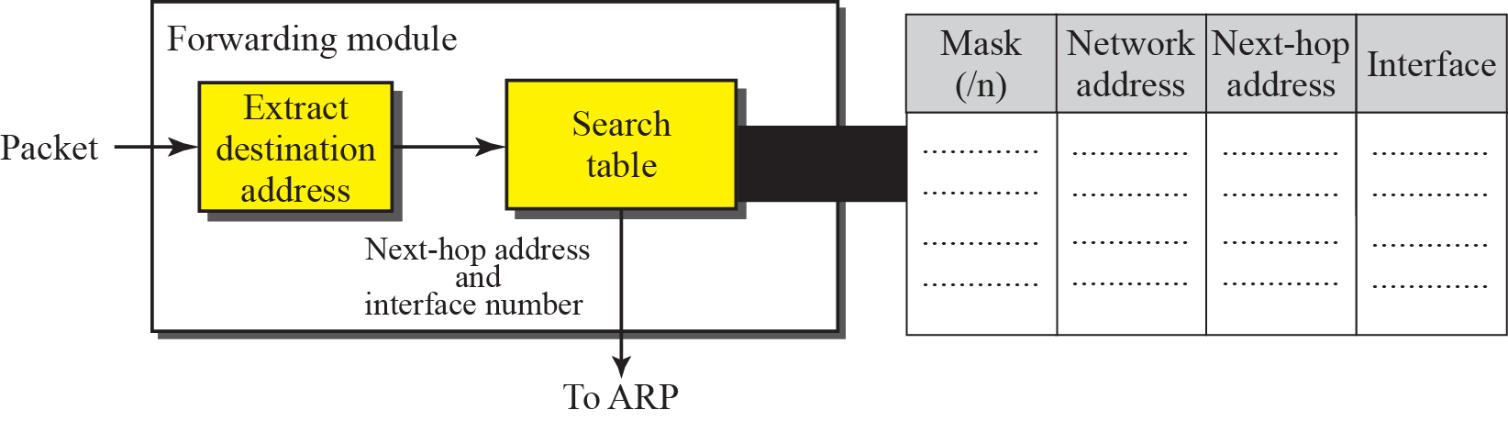
Contd..
Forwarding with Classless Addressing
Destination address in the packet gives no clue about the network address.
Need to include the mask (/n) in the table;
Need to have an extra column that includes the mask for the corresponding block.
Classless routing table needs at least four columns.
Figure 6.12 Simplified forwarding module in classless address

Slide 36
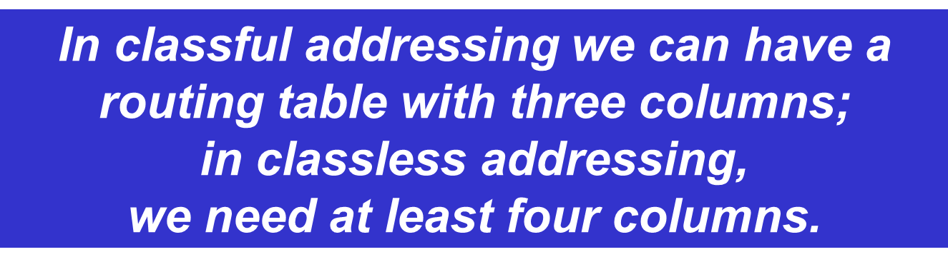
Contd..

Slide 37
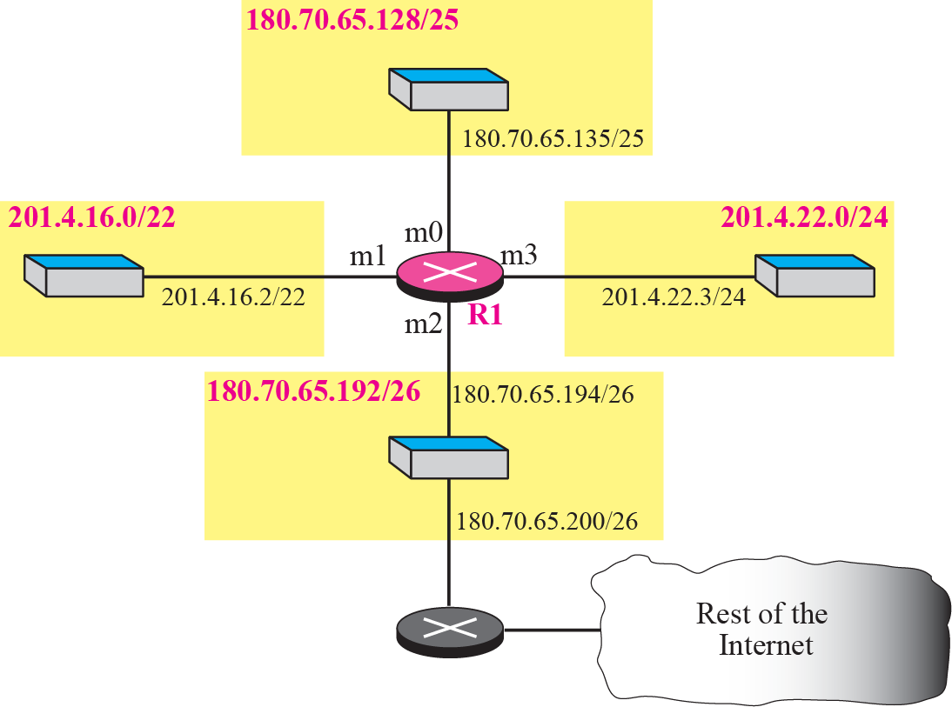
Example 7
Make a routing table for router R1 using the configuration in Figure

Slide 38
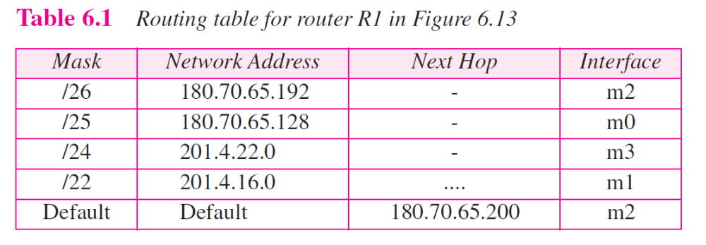
Contd..
Make a routing table for router R1 using the configuration in Figure 6.13.
Solution

Slide 39

Example 8
Show the forwarding process if a packet arrives at R1 in Figure with the destination address 180.70.65.140.

Slide 40
Contd..
Show the forwarding process if a packet arrives at R1 in Figure 6.13 with the destination address 180.70.65.140.
Solution
The router performs the following steps:
The first mask (/26) is applied to the destination address. The result is 180.70.65.128, which does not match the corresponding network address.
The second mask (/25) is applied to the destination address. The result is 180.70.65.128, which matches the corresponding network address.
The next-hop address (the destination address of the packet in this case) and the interface number m0 are passed to ARP for further processing.

Slide 41
Example 9
Show the forwarding process if a packet arrives at R1 in Figure with the destination address 201.4.22.35.

Slide 42
Contd..
Show the forwarding process if a packet arrives at R1 in Figure 6.13 with the destination address 201.4.22.35.
Solution
The router performs the following steps:
  The first mask (/26) is applied to the destination address. The result is 201.4.22.0, which does not match the corresponding network address.
  The second mask (/25) is applied to the destination address. The result is 201.4.22.0, which does not match the corresponding network address.
  The third mask (/24) is applied to the destination address. The result is 201.4.22.0, which matches the corresponding network address.
The destination address of the packet and the interface number m3 are passed to ARP

Slide 43
Example 10
Show the forwarding process if a packet arrives at R1 in Figure with the destination address 18.24.32.78.

Slide 44
Contd..
Show the forwarding process if a packet arrives at R1 in Figure 6.13 with the destination address 18.24.32.78.
Solution
This time all masks are applied to the destination address, but no matching network address is found.
When it reaches the end of the table, the module gives the next-hop address 180.70.65.200 and interface number m2 to ARP.
This is probably an outgoing package that needs to be sent, via the default router, to someplace else in the Internet.

Slide 45
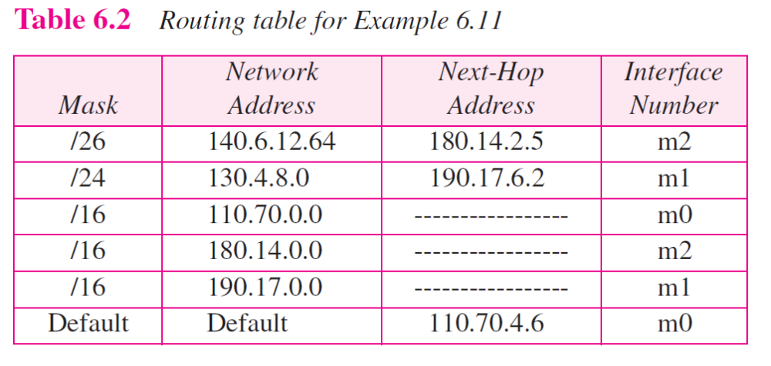
Example 11
The routing table for router R1 is given in Table 6.2. Draw its topology?

Slide 46
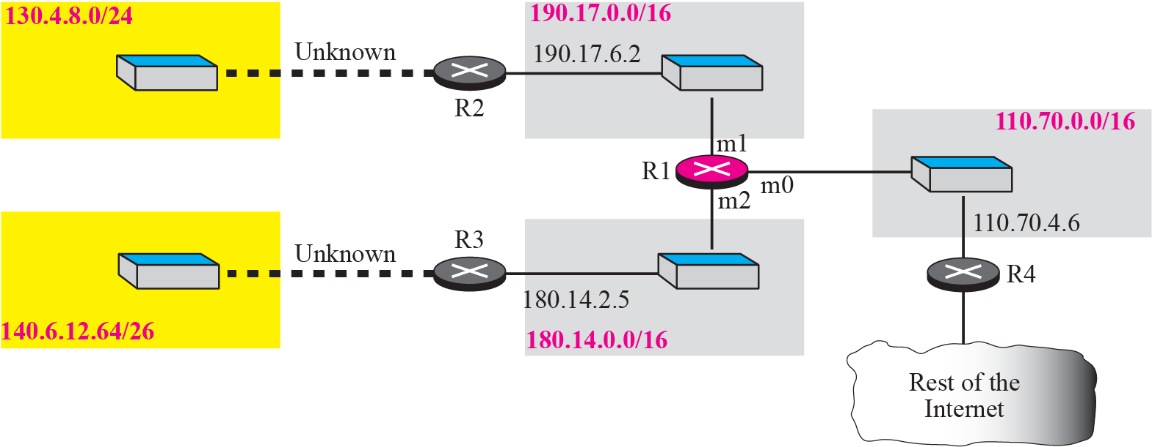
Contd..
Guessed topology for Example 6.11

Slide 47
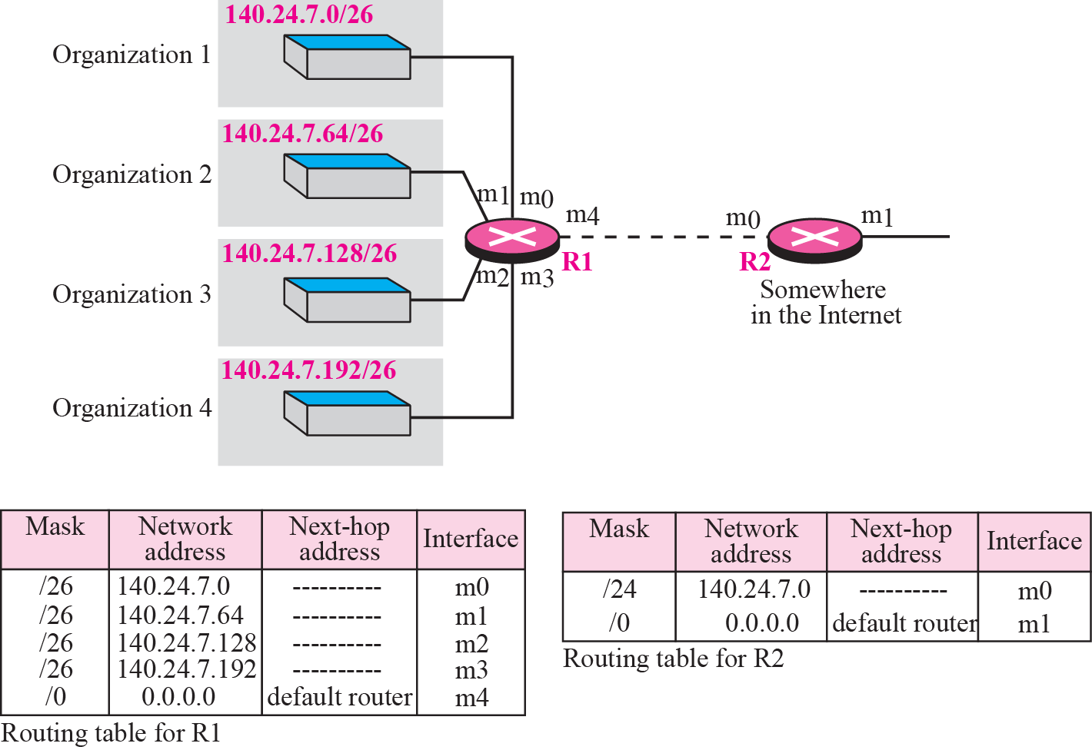
Address aggregation

Slide 48
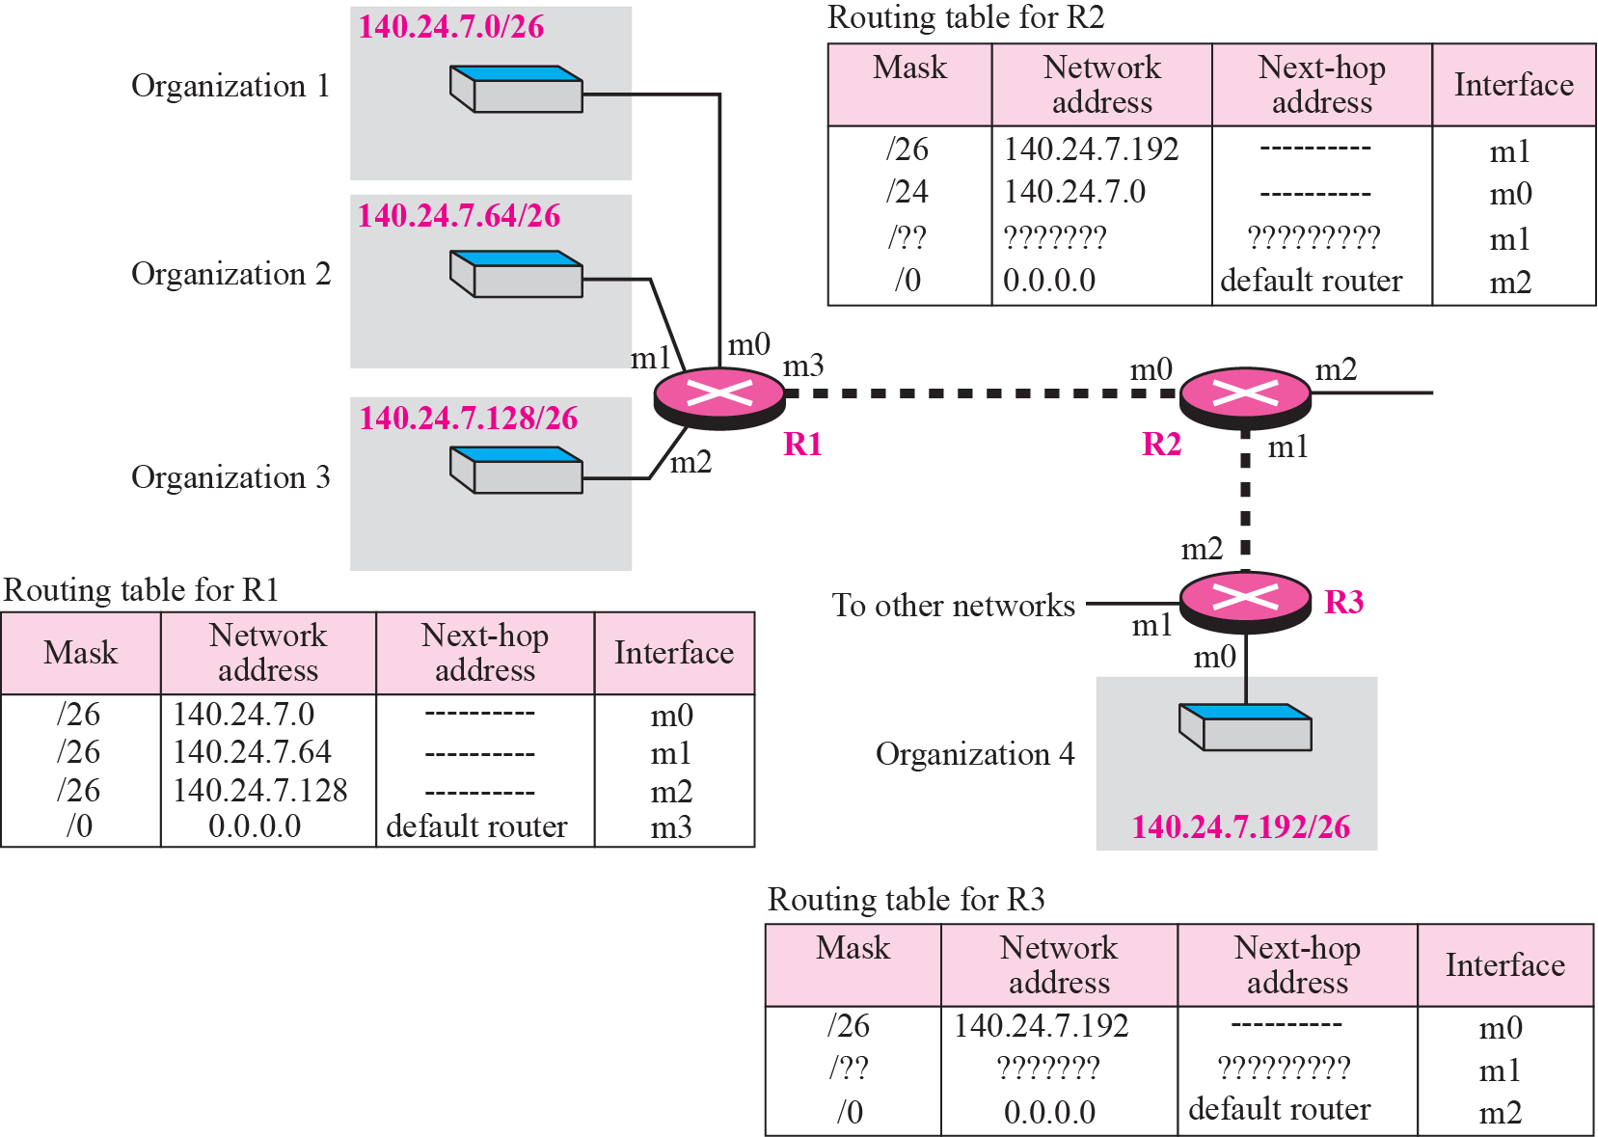
Longest mask matching
Example: Packet arrived at R2: 140.24.7.200.

Slide 49
Hierarchical routing with ISPs
To solve the problem of gigantic routing tables, we can create a hierarchy in the routing tables.
The Internet today has a sense of hierarchy. Internet is divided into backbone, regional and local ISPs.
If the routing table has a sense of hierarchy like the Internet architecture, the routing table can decrease in size.
Let us take the case of a local ISP. A local ISP can be assigned a single, but large, block of addresses with a certain prefix length.
The local ISP can divide this block into smaller blocks of different sizes, and assign these to individual users and organizations.
If the block assigned to the local ISP starts with a.b.c.d/n, the ISP can create blocks starting with e.f.g.h/m, where m may vary for each customer and is greater than n.

Slide 50
Contd..
How to reduce the size of the routing table ?
All customers of the local ISP are defined as a.b.c.d/n to the rest of the Internet.
Every packet destined for one of the addresses in this large block is routed to the local ISP. There is only one entry in every router in the world for all of these customers.
Inside the local ISP, the router must recognize the subblocks and route the packet to the destined customer.

Slide 51
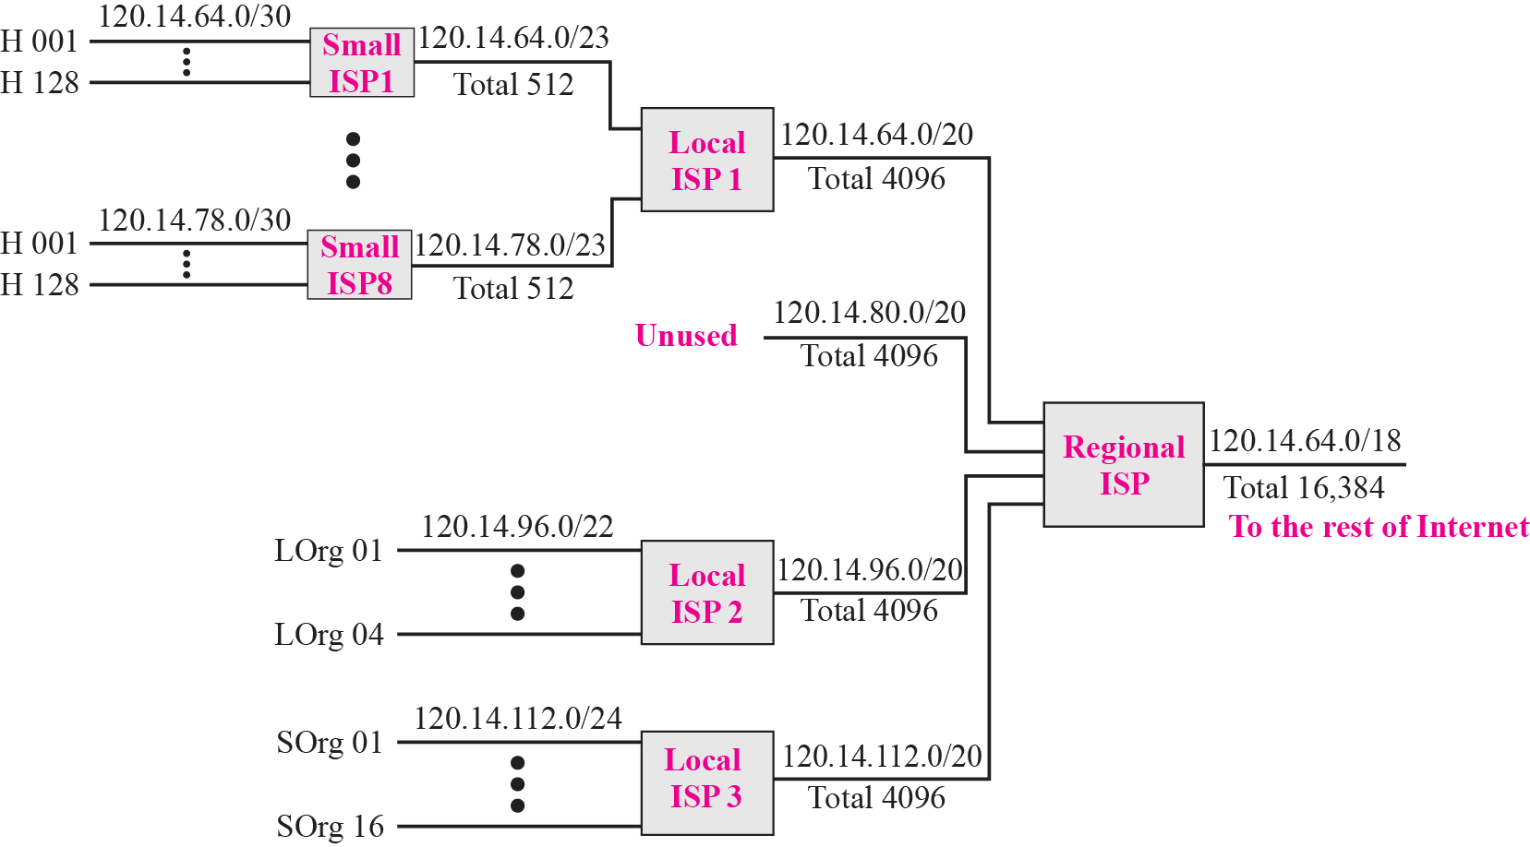
Contd..
Figure 6.17 Hierarchical routing with ISPs

Slide 52
Geographical Routing
To decrease the size of the routing table even further, we need to extend hierarchical routing to include geographical routing.
We must divide the entire address space into a few large blocks.
We assign a block to America, a block to Europe, a block to Asia, a block to Africa, and so on.
The routers of ISPs outside of Europe will have only one entry for packets to Europe in their routing tables.

Slide 53
Routing Table Search Algorithms
Searching in Classful Addressing
In classful addressing, the routing table is organized as a list.
To make searching more efficient, the routing table can be divided into three tables (called buckets), one for each class.
When the packet arrives, the router applies the default mask to find the corresponding bucket (A, B, or C).
The router then searches the corresponding bucket instead of the whole table.

Slide 54
Contd..
In classless addressing, there is no network information in the destination address.
The simplest, but not the most efficient, search method is called the longest prefix match.
The routing table can be divided into buckets, one for each prefix. The router first tries the longest prefix.
If the address is not found, the next prefix is searched. And so on.
It is obvious that this type of search takes a long time. One solution is to change the data structure used for searching.
Instead of a list, other data structures (such as a tree or a binary tree) can be used.

Slide 55
Forwarding Based on Label
In a connectionless network (datagram approach), a router forwards a packet based on the destination address.
In a connection-oriented network (virtual-circuit approach), a switch forwards a packet based on the label attached to a packet.
Routing is normally based on searching the contents of a table; switching can be done by accessing a table using an index.
In other words, routing involves searching; switching involves accessing.

Slide 56
Example 13
Figure shows example of searching in a routing table using the longest match algorithm.
When the forwarding algorithm gets the destination address of the packet, it needs to delve into the mask column.
For each entry, it needs to apply the mask to find the destination network address.
It then needs to check the network addresses in the table until it finds the match.
The router then extracts the next hop address and the interface number to be delivered to the ARP protocol for delivery of the packet to the next hop.

Slide 57
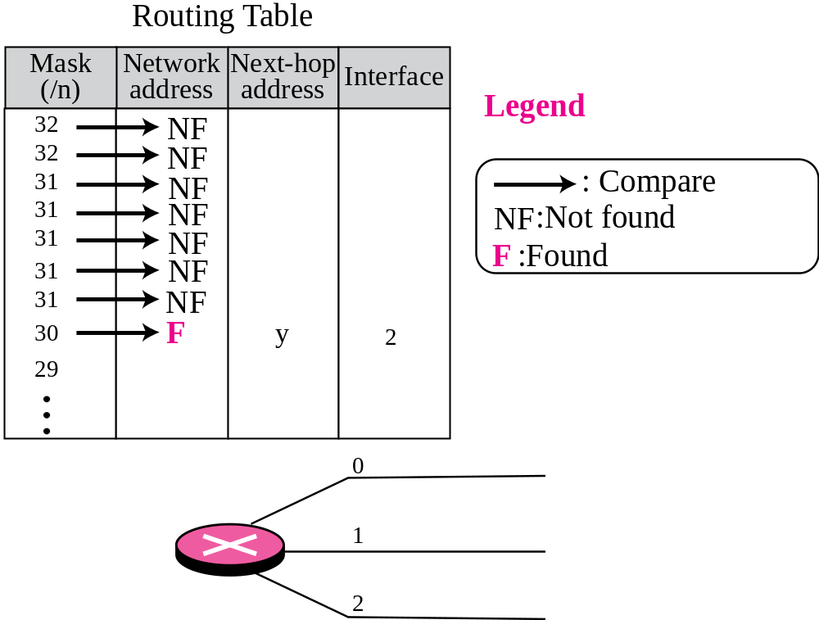
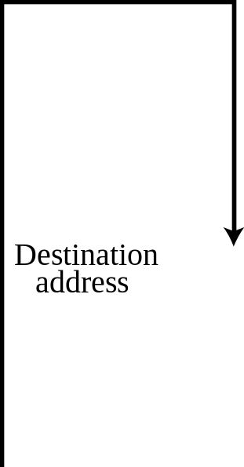
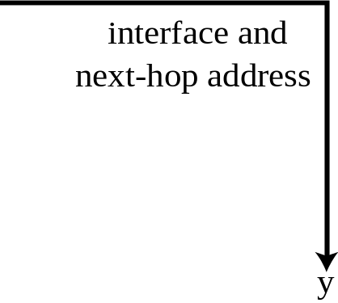

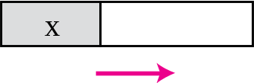
Contd..
Figure 6.18 Example 6.13: Forwarding based on destination address

Slide 58
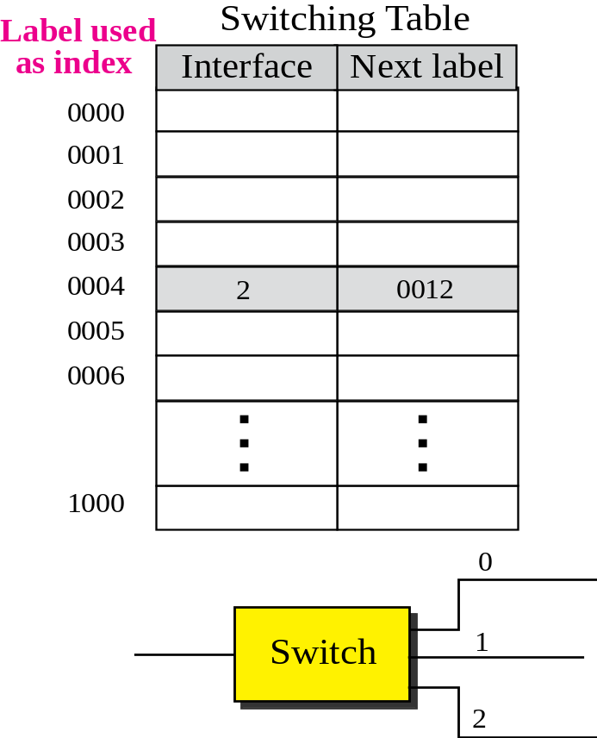
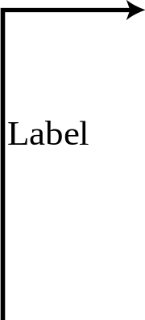
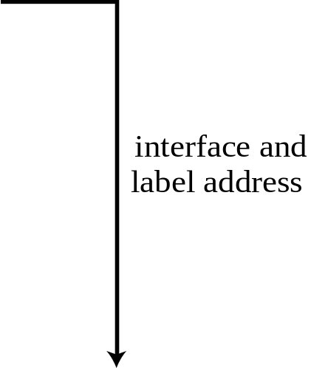


Example 14
Figure 6.19 shows a simple example of using a label to access a switching table.
Since the labels are used as the index to the table, finding the information in the table is immediate.

Slide 59

MPLS (Multi Protocol Label Switching)
Here some conventional routers in the Internet can be replaced by MPLS routers that can behave like a router and a switch.
When behaving like a router, MPLS can forward the packet based on the destination address; when behaving like a switch, it can forward a packet based on the label.
To simulate connection-oriented switching using a protocol like IP, the first thing needed is to add a field to the packet that carry the label.
The whole IP packet is encapsulated as the payload in an MPLS packet and MPLS header is added.
Figure 6.20 MPLS header added to an IP packet

Slide 60
Internet Protocol
Objectives
Upon completion you will be able to:
Understand the format and fields of a datagram
Understand the need for fragmentation and the fields involved
Understand the options available in an IP datagram
Be able to perform a checksum calculation
Understand the components and interactions of an IP package

Slide 61
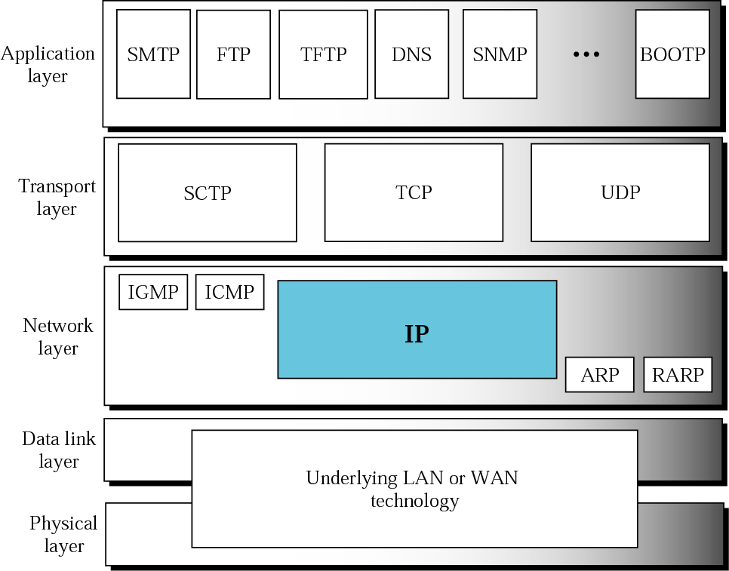
Position of IP in TCP/IP protocol suite
The Internet Protocol (IP) is the transmission mechanism used by the TCP/IP protocols at the network layer

Slide 62
Contd..
IP is an unreliable and connectionless datagram protocol—a best-effort delivery service.
IP packets can be corrupted, lost, arrive out of order, or delayed and may create congestion for the network.
If reliability is important, IP must be paired with a reliable protocol such as TCP. Ex: normal post vs registered post.
IP is a connectionless protocol.
Each datagram is handled independently, and each datagram can follow a different route to the destination.
Datagrams sent by the same source to the same destination could arrive out of order.
Some could be lost or corrupted during transmission.
IP relies on a higher-level protocol to take care of all these problems.

Slide 63
Contd..
Packets in the network (internet) layer are called datagrams.
A datagram is a variable-length packet consisting of two parts: header and data.
The header is 20 to 60 bytes in length and contains information essential to routing and delivery.

Slide 64
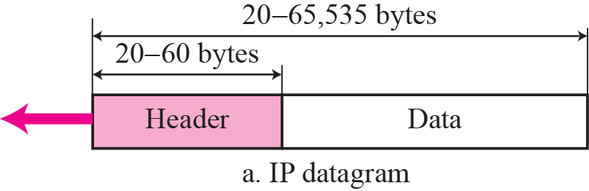
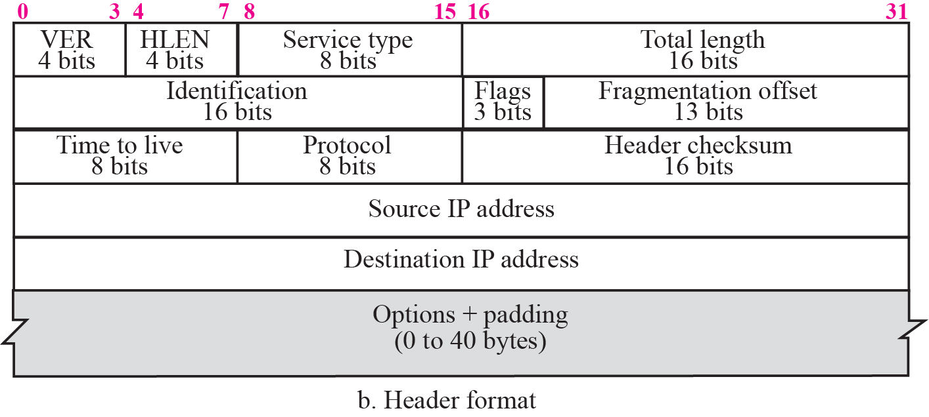
IP datagram

Slide 65
Contd..
Header length (HLEN).
Defines the total length of the datagram header.
This field is needed because the length of the header is variable (between 20 and 60 bytes).
When there are no options, the header length is 20 bytes, and the value of this field is 5 (5 × 4 = 20).
When the option field is at its maximum size, the value of this field is 15 (15 × 4 = 60).

Slide 66
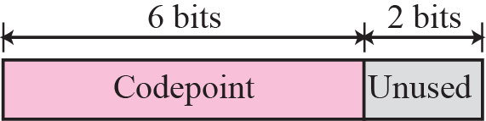
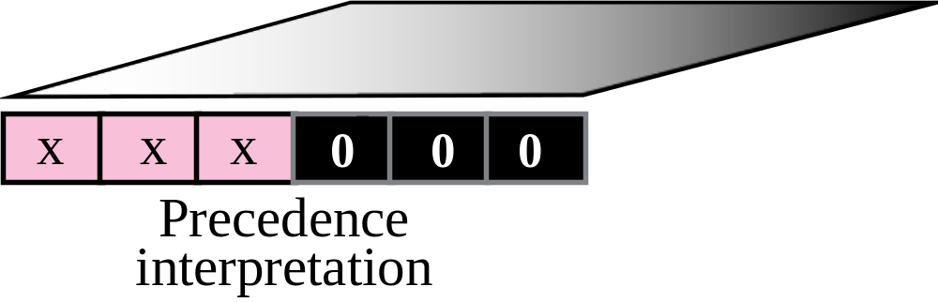
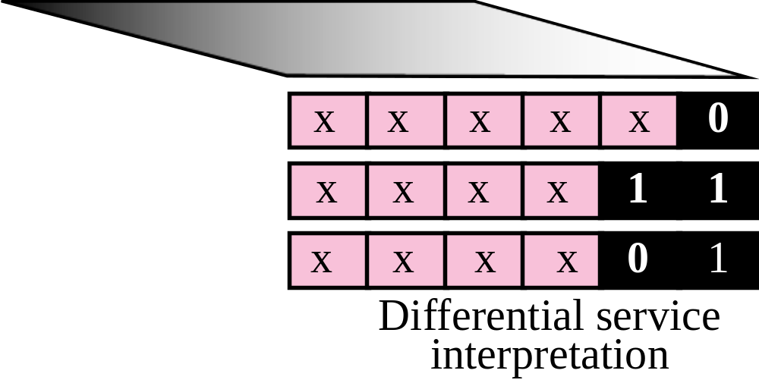
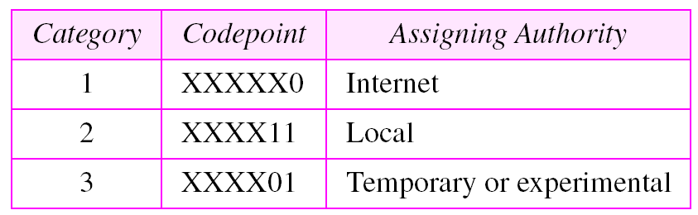
Contd..
Service Type
Defined how the datagram should be handled.
Part of the field was used to define the precedence of the datagram;

Slide 67

Contd..
Total length
Defines the total length (header plus data) of the IP datagram in bytes.
To find the length of the data coming from the upper layer, subtract the header length from the total length.
Length of data = total length − header length
Note:
The total length field defines the total length of the datagram including the header.

Slide 68
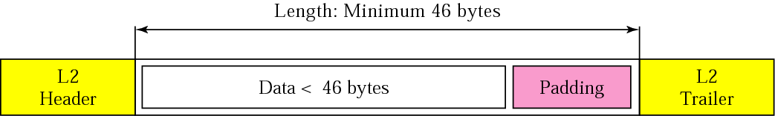
Contd..
Many cases we really do not need the value in this field.
There are occasions in which the datagram is not the only thing encapsulated in a frame; it may be that padding has been added.
Ex: Ethernet protocol has a minimum and maximum restriction on the size of data that can be encapsulated in a frame (46 to 1500 bytes).
If the size of an IP datagram is less than 46 bytes, some padding will be added to meet this requirement.
Figure 8.4 Encapsulation of a small datagram in an Ethernet frame

Slide 69
Contd..
Time to live
A datagram has a limited lifetime in its travel through an internet.
Originally designed to hold a timestamp.
Issue : synchronized clocks and must know how long it takes for a datagram to go from one machine to another.
Today, this field is mostly used to control the maximum number of hops (routers) visited by the datagram.
When a source host sends the datagram, it stores a number in this field. This value is approximately two times the maximum number of routes between any two hosts.
Each router that processes the datagram decrements this number by one. If this value, after being decremented, is zero, the router discards the datagram.

Slide 70
Contd..
This field is needed because routing tables in the Internet can become corrupted.
A datagram may travel between two or more routers for a long time without ever getting delivered to the destination host.
This field limits the lifetime of a datagram.
Another use of this field is to intentionally limit the journey of the packet.
For example, if the source wants to confine the packet to the local network, it can store 1 in this field.

Slide 71
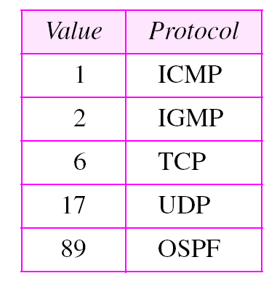
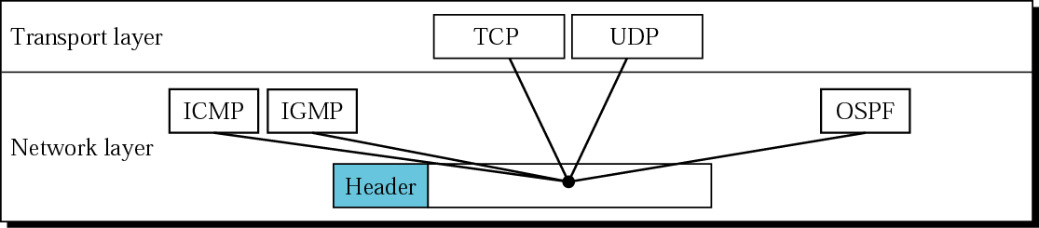
Contd..
Protocol
This 8-bit field defines the higher-level protocol that uses the services of the IP layer.
An IP datagram can encapsulate data from several higher level protocols such as TCP, UDP, ICMP.
This field specifies the final destination protocol to which the IP datagram should be delivered.
Figure 8.5 Multiplexing

Slide 72
Example 1
An IP packet has arrived with the first 8 bits as shown:
The receiver discards the packet. Why?
Solution
There is an error in this packet. The 4 left-most bits (0100) show the version, which is correct. The next 4 bits (0010) show the header length; which means (2 × 4 = 8), which is wrong. The minimum number of bytes in the header must be 20. The packet has been corrupted in transmission.
01000010

Slide 73
Example 2
In an IP packet, the value of HLEN is 1000 in binary. How many bytes of options are being carried by this packet?
TCP/IP Protocol Suite

Slide 74
Example 2
In an IP packet, the value of HLEN is 1000 in binary. How many bytes of options are being carried by this packet?
Solution
The HLEN value is 8, which means the total number of bytes in the header is 8 × 4 or 32 bytes. The first 20 bytes are the base header, the next 12 bytes are the options.
TCP/IP Protocol Suite

Slide 75
Example 3
In an IP packet, the value of HLEN is 5₁₆
and the value of the total length field is 0028₁₆ . How
many bytes of data are being carried by this packet?
TCP/IP Protocol Suite

Slide 76
Example 3
In an IP packet, the value of HLEN is 5₁₆
and the value of the total length field is 0028₁₆ . How
many bytes of data are being carried by this packet?
Solution
The HLEN value is 5, which means the total number of bytes in the header is 5 × 4 or 20 bytes (no options). The total length is 40 bytes, which means the packet is carrying 20 bytes of data (40 − 20).
TCP/IP Protocol Suite

Slide 77
Example 4
An IP packet has arrived with the first few hexadecimal digits as shown below:
45000028000100000106 . . .
How many hops can this packet travel before being dropped? The data belong to what upper layer protocol?
Solution
To find the time-to-live field, we skip 8 bytes (16 hexadecimal digits). The time-to-live field is the ninth byte, which is 01. This means the packet can travel only one hop. The protocol field is the next byte (02), which means that the upper layer protocol is TCP.
TCP/IP Protocol Suite

Slide 78
FRAGMENTATION
The format and size of a frame depend on the protocol used by the physical network. A datagram may have to be fragmented to fit the protocol regulations.
The topics discussed in this section include:
Maximum Transfer Unit (MTU)
Fields Related to Fragmentation

Slide 79
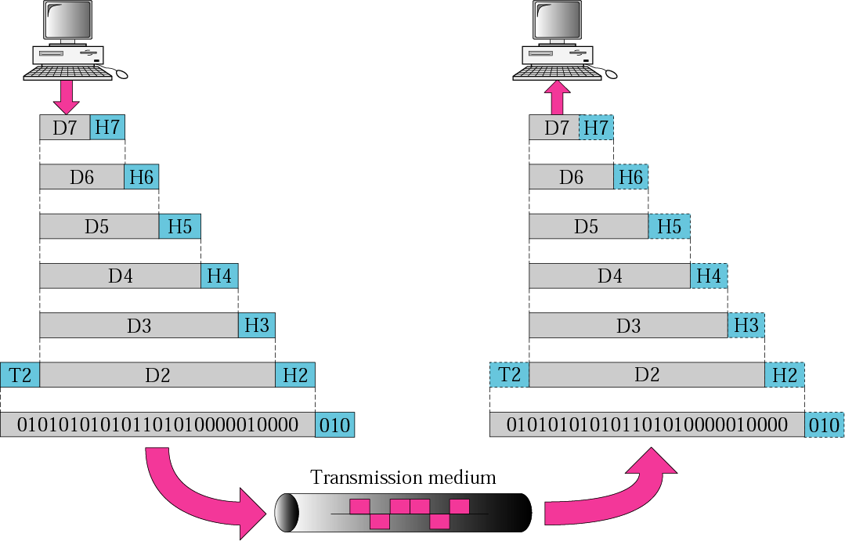
Contd..
A datagram can travel through different networks.
Each router decapsulates the IP datagram from the frame it receives, processes it, and then encapsulates it in another frame.

Slide 80
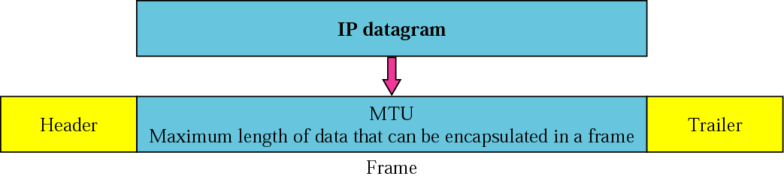
Contd…
Maximum Transfer Unit (MTU)
Each data link layer protocol has its own frame format.
One of the fields defined in the format is the maximum size of the data field.
When a datagram is encapsulated in a frame, the total size of the datagram must be less than this maximum size.

Slide 81
Contd..
The value of the MTU differs from one physical network protocol to another.
For example, the value for the Ethernet LAN is 1500 bytes, for FDDI LAN is 4352 bytes, and for PPP is 296 bytes.
The maximum length of the IP datagram equal to 65,535 bytes.
We must divide the datagram to make it possible to pass through these networks. This is called fragmentation.
When a datagram is fragmented, each fragment has its own header with most of the fields repeated, but some changed.
A fragmented datagram may itself be fragmented if it encounters a network with an even smaller MTU.
A datagram can be fragmented by any router in the path.

Slide 82
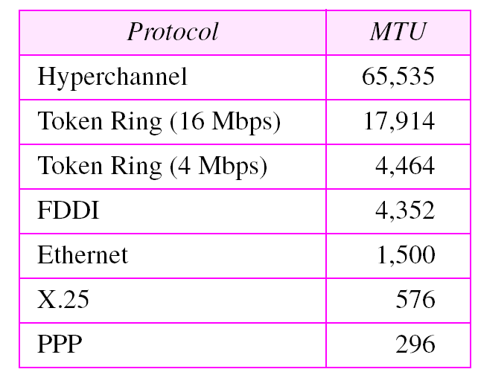
Contd..
The reassembly of the datagram, is done only by the destination host.
When a datagram is fragmented, required parts of the header must be copied by all fragments.
The host or router that fragments a datagram must change the values of three fields: flags, fragmentation offset, and total length.
The rest of the fields must be copied.
The value of the checksum must be recalculated regardless of fragmentation.

Slide 83
Contd..
Fields Related to Fragmentation

Slide 84
Contd..
Fields Related to Fragmentation
Fields related to fragmentation and reassembly of an IP datagram are the identification, flags, and fragmentation offset
Identification
This 16-bit field identifies a datagram originating from the source host.
Combination of the identification and source IP address must uniquely define a datagram.
When a datagram is fragmented, the value in the identification field is copied into all fragments.
The identification number helps the destination in reassembling the datagram.

Slide 85
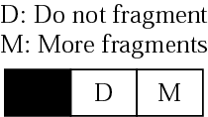
Contd..
Flags
This is a three-bit field. The first bit is reserved (not used).
The second bit is called the do not fragment bit. If its value is 1, the machine must not fragment the datagram.
If it cannot pass the datagram through any available physical network, it discards the datagram and sends an ICMP error message to the source host. If its value is 0, the datagram can be fragmented if necessary.
The third bit is called the more fragment bit. If its value is 1, it means the datagram is not the last fragment; there are more fragments after this one. If its value is 0, it means this is the last or only fragment.

Slide 86
Contd..
Fragmentation offset
This 13-bit field shows the relative position of this fragment with respect to the whole datagram.
It is the offset of the data in the original datagram measured in units of 8 bytes.
Example: a datagram with a data size of 4000 bytes fragmented into three fragments.
The bytes in the original datagram are numbered 0 to 3999.
First fragment carries bytes 0 to 1399. Offset for this datagram is 0/8 = 0.
Second fragment carries bytes 1400 to 2799; offset for this fragment is 1400/8 = 175.
Third fragment carries bytes 2800 to 3999. Offset value for this fragment is 2800/8 = 350.

Slide 87
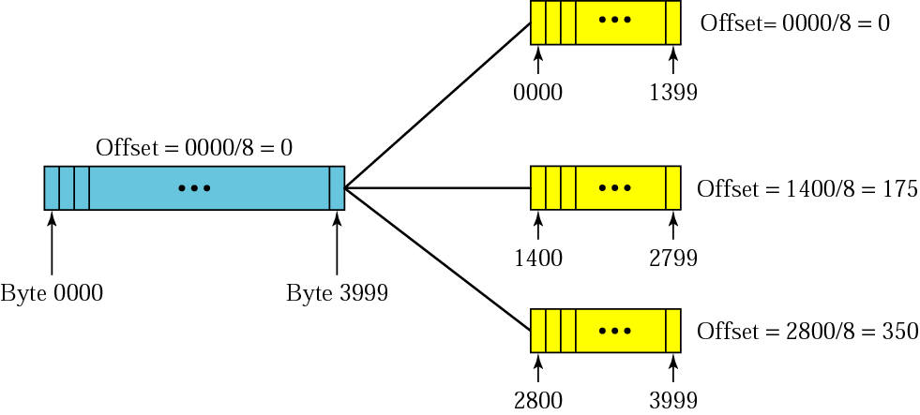
Contd..
The offset is measured in units of 8 bytes because the length of the offset field is only 13 bits long and cannot represent a sequence of bytes greater than 8191.

Slide 88

Contd..
The value of the identification field is the same in all fragments.
The value of the flags field with the more bit set for all fragments except the last. (1400+800)/2 = 275

Slide 89
Contd..
Detailed fragmentation example
Even if each fragment follows a different path and arrives out of order, the final destination host can reassemble the original datagram from the fragments received (if none of them is lost) using the following strategy:
The first fragment has an offset field value of zero.
Divide the length of the first fragment by 8. The second fragment has an offset value equal to that result.
Divide the total length of the first and second fragment by 8. The third fragment has an offset value equal to that result.
Continue the process. The last fragment has a more bit value of 0

Slide 90
Example 5
A packet has arrived with an M bit value of 0. Is this the first fragment, the last fragment, or a middle fragment? Do we know if the packet was fragmented?
Solution
If the M bit is 0, it means that there are no more fragments; the fragment is the last one.
However, we cannot say if the original packet was fragmented or not. A nonfragmented packet is considered the last fragment.

Slide 91
Example 6
A packet has arrived with an M bit value of 1. Is this the first fragment, the last fragment, or a middle fragment? Do we know if the packet was fragmented?
Solution
If the M bit is 1, it means that there is at least one more fragment. This fragment can be the first one or a middle one, but not the last one.
We don’t know if it is the first one or a middle one; we need more information (the value of the fragmentation offset).

Slide 92
Example 7
A packet has arrived with an M bit value of 1 and a fragmentation offset value of zero. Is this the first fragment, the last fragment, or a middle fragment?.
Solution
Because the M bit is 1, it is either the first fragment or a middle one. Because the offset value is 0, it is the first fragment.

Slide 93
Example 8
A packet has arrived in which the offset value is 100. What is the number of the first byte? Do we know the number of the last byte?
Solution
To find the number of the first byte, we multiply the offset value by 8. This means that the first byte number is 800.
We cannot determine the number of the last byte unless we know the length of the data.

Slide 94
Example 9
A packet has arrived in which the offset value is 100, the value of HLEN is 5 and the value of the total length field is 100. What is the number of the first byte and the last byte?
Solution
The first byte number is 100 × 8 = 800. The total length is 100 bytes and the header length is 20 bytes (5 × 4), which means that there are 80 bytes in this datagram. If the first byte number is 800, the last byte number must be 879.

Slide 95
Contd..
Suppose 1MByte of application data (including application layer header) has to be sent out of a host attached to Ethernet. Assume the application uses TCP protocol and that the IP as well as TCP header is 20 bytes each. Further assume that Ethernet MTU size is 1500. How many datagrams are sent out of the host?
Ans. 675
Since we are using Ethernet, the MTU size is 1500. Of this 20 bytes will go to the IP headers. So, each datagram carries 1480 bytes (application data +TCP header). So, the number of datagrams is ceil((10^6+20)/1480) = 675.

Slide 96
Contd..
What is the size (in bytes) of the last datagram? Express answer in bytes.
Solution:
1020 data+20 IP header =1040
1000020 – (1480 *675) = 1020
What is the value of the offset field in the last fragment? Format X (e.g. 136)
Solution: 244

Slide 97
Example 10
Suppose a TCP message of 2000 bytes of data and 20 bytes of TCP header is passed to the IP layer. Suppose this host is connected to a link with an MTU size of 512 Bytes. Assume header size of IP is 20 bytes. What is the total length of the last IP fragment? Express in bytes.
Solution: 88
Total payload to the IP layer is 2020 bytes.
The MTU size is 512, out of which payload size is only 492. Since 492 is not a multiple of 8, payload is 488.
2020 bytes of data has to be distributed over 5 fragments, where the first 4 carry 488 bytes and the last carries the remaining 68.
Total length of the last fragment is 68+20 = 88

Slide 98


Example 11

Slide 99
Example 12
Suppose a Transport Layer segment of 8000 Bytes is passed to the Network Layer for delivery across 2 networks of the internet, from source host A to destination host B. Assume that host A is connected to host B through router R1. The first network (from host A to router R1) can allow an IP datagram of size 3000 bytes to pass through it, while the second network (from router R1 to host B) allows an IP datagram of size 1800 bytes to pass through it. If all the fragments reach safely at the destination, show the offset and flag values for each of the fragments. Assume all IP headers are 20 bytes.

Slide 100
Checksum
The error detection method used by most TCP/IP protocols is called the checksum.
The checksum protects against the corruption that may occur during the transmission of a packet.
It is redundant information added to the packet.
The checksum is calculated at the sender and the value obtained is sent with the packet.
The receiver repeats the same calculation on the whole packet including the checksum.
If the result is satisfactory (see below), the packet is accepted; otherwise, it is rejected.

Slide 101
Checksum Calculation at the Sender
At the sender, the packet header is divided into n-bit sections (n is usually 16).
These sections are added together using one’s complement arithmetic, resulting in a sum that is also n bits long.
The sum is then complemented (all 0s changed to 1s and all 1s to 0s) to produce the checksum.
To create the checksum the sender does the following:
The packet is divided into k sections, each of n bits.
All sections are added together using one’s complement arithmetic.
The final result is complemented to make the checksum.

Slide 102

Contd..
Figure 7.24 shows an example of a checksum calculation at the sender site for an IP header without options. The header is divided into 16-bit sections. All the sections are added and the sum is complemented. The result is inserted in the checksum field.

Slide 103

Checksum Calculation at the Receiver
The receiver divides the received packet into k sections and adds all sections.
It then complements the result.
If the final result is 0, the packet is accepted; otherwise, it is rejected.
Figure 7.22 shows graphically what happens at the sender and the receiver.

Slide 104

Contd..
We said when the receiver adds all of the sections and complements the result, it should get zero if there is no error in the data during transmission or processing.
Assume that we get a number called T when we add all the sections in the sender. When we complement the number in one’s complement arithmetic, we get the negative of the number. This means that if the sum of all sections is T, the checksum is −T.

Slide 105

Contd..
Figure 7.25 shows the checking of checksum calculation at the receiver site (or intermediate router) assuming that no errors occurred in the header. The header is divided into 16-bit sections. All the sections are added and the sum is complemented. Since the result is 16 0s, the packet is accepted

Slide 106
Example 2
4 | 5 | 0 | 91
80 |  |  | 0 | 180
5 |  | 6 | 0
192.168.1.12
172.16.32.4

Slide 107
Contd..
4, 5 | 0 | 01000101 | 00000000
0 | 91 | 000000000 | 01011011
0 | 80 | 00000000 | 01010000
0 | 180 | 00000000 | 10110100
5 | 6 | 00000101 | 00000110
0 | 0 | 00000000 | 00000000
192 | 168 | 11000000 | 10101000
1 | 12 | 00000001 | 00001100
172 | 16 | 10101100 | 00010000
32 | 4 | 00100000 | 00000100
 |  | 11010111 | 1000101101
 |  | 00000010
 | 1 | 11011001 | 00101101
 |  |  | 00000001
 |  | 11011001 | 00101110
4 | 5 | 0 | 91
80 |  |  | 0 | 180
5 |  | 6 | 0
192.168.1.12
172.16.32.4
sum
Carry forward
Carry forward
Checksum : 9937

Slide 108
Contd..
4, 5 | 0 | 01000101 | 00000000
0 | 91 | 000000000 | 01011011
0 | 80 | 00000000 | 01010000
0 | 180 | 00000000 | 10110100
5 | 6 | 00000101 | 00000110
38 | 209 | 00100110 | 11010001
192 | 168 | 11000000 | 10101000
1 | 12 | 00000001 | 00001100
172 | 16 | 10101100 | 00010000
32 | 4 | 00100000 | 00000100
 |  | 111111101 | 1011111110
 |  | 00000010
 | 1 | 11111111 | 11111110
 |  |  | 00000001
 |  | 11111111 | 11111111
 |  | 00000000 | 00000000
4 | 5 | 0 | 91
80 |  |  | 0 | 180
5 |  | 6 | 9937
192.168.1.12
172.16.32.4
Header Checksum
9937
sum
Carry forward
Carry forward
Sum
Checksum

Slide 109
Checksum in the IP Packet
The implementation of the checksum in the IP packet follows the same principles discussed above.
First, the value of the checksum field is set to 0.
Then, the entire header is divided into 16-bit sections and added together. The result (sum) is complemented and inserted into the checksum field.
The checksum in the IP packet covers only the header, not the data.
There are two good reasons for this. First, all higher-level protocols that encapsulate data in the IP datagram have a checksum field that covers the whole packet. Therefore, the checksum for the IP datagram does not have to check the encapsulated data.
Second, the header of the IP packet changes with each visited router, but the data do not. So the checksum includes only the part that has changed. If the data were included, each router would have to recalculate the checksum for the whole packet, which means an increase in processing time.

Slide 110
OPTIONS

Slide 111




Contd..
Options are not required for a datagram.
They can be used for network testing and debugging.
Composed of a 1-byte type field, a 1-byte length field, and a variable-sized value field.
The three fields are often referred to as type-length-value or TLV.

Slide 112
Contd..
Type
Contains 3 subfields: copy, class, and number.
Copy.
  Controls the presence of the option in fragmentation.
  0 -> The option must be copied only to the first fragment.
  1 -> The option must be copied to all fragments.
Class.
  Defines the general purpose of the option.
  00 -> the option is used for datagram control.
  10 -> the option is used for debugging and management.
Number.
  Defines the type of option.
  Currently only 6 types are in use.

Slide 113
Contd..
Length
  Defines the total length of the option including the type field and the length field itself.
  This field is not present in all of the option types.
Value
  The value field contains the data that specific options require.
  This field is also not present in all option types

Slide 114

Contd..
Option Types
Two of these are 1-byte options, and they do not require the length or the data fields.
Four of them are multiple-byte options; they require the length and the data fields .

Slide 115



Contd..
No-Operation Option
Used as a filler between options.
Used to align the next option on a 16-bit or 32-bit boundary.

Slide 116


Contd..
End-of-Option Option
Used for padding at the end of the option field.
Can only be used as the last option.
Only one end-of-option option can be used. After this option, the receiver looks for the payload data.
This means that if more than 1 byte is needed to align the option field, some no-operation options must be used, followed by an end-of-option option.

Slide 117

Contd..
Record-Route Option
It can list up to 9 router IP addresses.
Source creates placeholder fields in the option to be filled by the visited routers.

Slide 118
Contd..
The pointer field is an offset integer field containing the byte number of the first empty entry.
It points to the first available entry.
The source creates empty fields for the IP addresses in the data field of the option.
The pointer field has a value of 4, pointing to the first empty field.
When the datagram is traveling, each router that processes the datagram compares the value of the pointer with the value of the length.
If the value of the pointer is greater than the value of the length, the option is full and no changes are made.
If the value of the pointer is not greater than the value of the length, the router inserts its outgoing IP address in the next empty field.
The router then increments the value of the pointer by 4.

Slide 119

Contd..

Slide 120
Contd..
Strict source route option
It is used by the source to predetermine a route for the datagram as it travels through the Internet.
A sender can choose a route so that its datagram does not travel through a competitor’s network.
If a datagram specifies a strict source route, all of the routers defined in the option must be visited by the datagram.
Regular users of the Internet, however, are not usually aware of the physical topology of the Internet.
Strict source routing is not the choice of most users.

Slide 121

Contd..
The format is similar to the record route option with the exception that all of the IP addresses are entered by the sender.

Slide 122
Contd..
When the datagram is traveling, each router that processes the datagram compares the value of the pointer with the value of the length.
If the value of the pointer is greater than the value of the length, the datagram has visited all of the predefined routers.
If the value of the pointer is not greater than the value of the length, the router compares the destination IP address with its incoming IP address: If they are equal, it processes the datagram, swaps the IP address pointed by the pointer with the destination address, increments the pointer value by 4, and forwards the datagram.
If they are not equal, it discards the datagram and issues an error message.

Slide 123

Contd..

Slide 124

Contd..
Loose source route option
A loose-source-route option is similar to the strict source route, but it is more relaxed.
Each router in the list must be visited, but the datagram can visit other routers as well.

Slide 125
Contd..
Timestamp option
Used to record the time of datagram processing by a router.
Help users and managers track the behavior of the routers in the Internet.
We can estimate the time it takes for a datagram to go from one router to another.
Nonprivileged users of the Internet are not usually aware of the physical topology of the Internet.
Timestamp option is not a choice for most users.

Slide 126

Contd..

Slide 127

Contd..
The overflow field records the number of routers that could not add their timestamp because no more fields were available.
The flags field specifies the visited router responsibilities.
  0 -> each router adds only the timestamp in the provided field.
  1-> each router must add its outgoing IP address and the timestamp.
  3 -> the IP addresses are given, and each router must check the given IP address with its own incoming IP address.

Slide 128

Contd..
Figure shows the actions taken by each router when a datagram travels from source to destination. ( assumes a flag value of 1).

Slide 129
Example 13
Which of the six options must be copied to each fragment?
  No operation: Code is 00000001;
  End of option: Code is 00000000;
  Record route: Code is 00000111;
  Strict source route: Code is 10001001;
  Loose source route: Code is 10000011;
  Timestamp: Code is 01000100;
Solution
We look at the first (left-most) bit of the code for each option.
d. Strict source route: Code is 10001001; copied.
e. Loose source route: Code is 10000011; copied.

Slide 130
Example 14
Which of the six options are used for datagram control and which are used for debugging and management?
a. No operation: Code is 00000001;.
b. End of option: Code is 00000000;.
c. Record route: Code is 00000111;.
d. Strict source route: Code is 10001001;.
e. Loose source route: Code is 10000011;.
f. Time stamp: Code is 01000100;
Solution
We look at the second and third (left-most) bits of the code.
  a. No operation: Code is 00000001; datagram control.
  b. End of option: Code is 00000000; datagram control.
  c. Record route: Code is 00000111; datagram control.
  d. Strict source route: Code is 10001001; datagram control.
  e. Loose source route: Code is 10000011; datagram control.
  f. Time stamp: Code is 01000100; debugging and management control.

Slide 131


